Slide 1
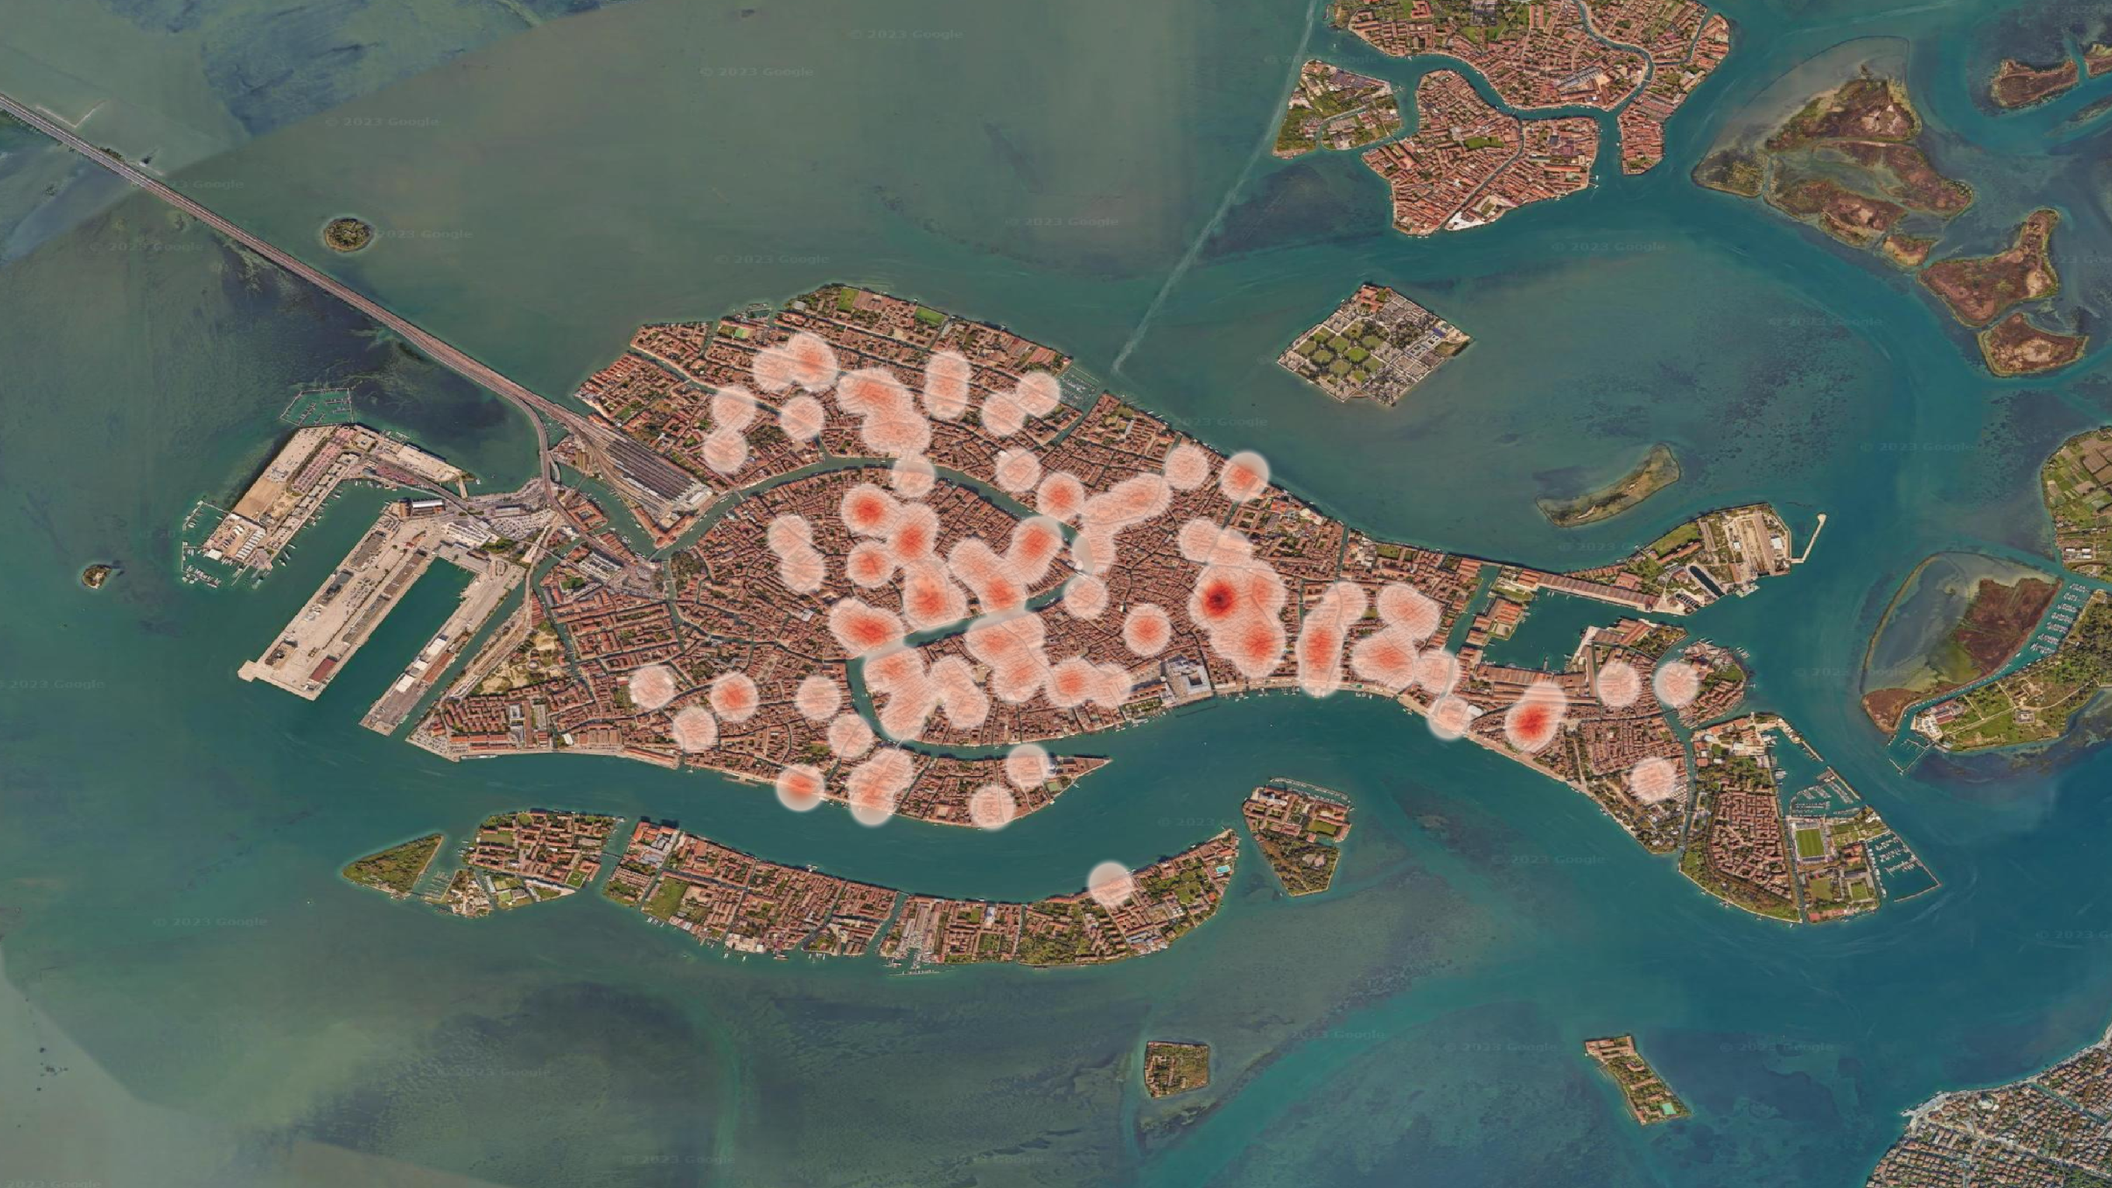
Density of Antibandito Stones:
1 2 4
Image Credit: Google Earth, Imagery Date 10/10/2022

